Slide 1
Self driving car documentation
May 2024

Slide 2
Project introduction
The project goal is to demonstrate research possibility in self driving road vehicles.
This is achieved by testing algorithms on our Kia Soul EV 2017.
Reminder : The project does not aim to be as good as Tesla’s or commercial self driving, but aims to test research algorithms.

Slide 3
Install a new PC
When joining the team, you are required to have a working system to test the algorithms.
Ubuntu 20.04 / Linux Mint 20 / Ubuntu 22.04 / Linux Mint 21
A github repository containing installation scripts for the base system is present : https://github.com/irh-ca-team-car/setup-workstation
The rest of the project code is divided against multiple repositories. A separate presentation will present each module and how to install it. For an overview of the modules, visit Teams for Diagrams of interaction in which each node identify the repository in which it is contained.

Slide 4
Install a new Xavier unit
Since the vehicle runs on Nvidia Jetson Xavier AGX units, a separate presentation InstallXavier.pptx is available
Xaviers use Ubuntu 20.04 on arm64, their power is limited but they have 32Gb of video ram. You can either compiler from C++ using Cuda or use Pytorch in order to have GPU code.
.So files for x64 won’t work. Generally code repositories which contains both .py and .c for optimized code won’t work.
OpenCV is CPU only for now, use with caution as it’s slow.

Slide 5
Sensors and computers
FLIR ADK
Robosense RS-Lidar-16
Continental ARS408 (Unconnected)
Jetson AGX Xavier (x3)
Network switch
LTE router
Wifi AC router
Drivekit
Greenbox (Some Canbus over usb box)
200Ah LifePo4 battery
Septentrio RTK GPS(Mosaic-X5)
Stereolabs Zed2i(x4) (RGB + IMU + Magnetometer + Barometer)
Mynteye (Grayscale + IMU)

Slide 6
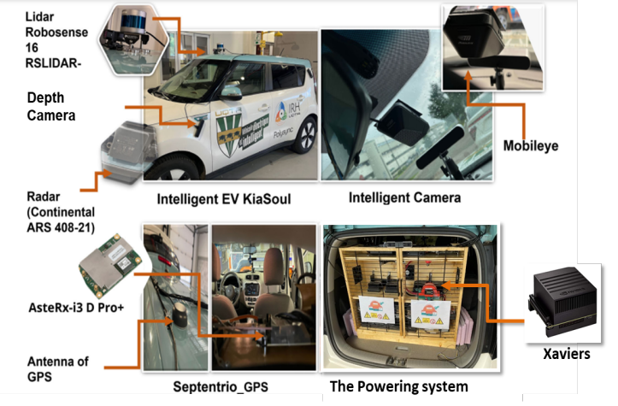
Sensors
Mosaic-X5

Slide 7
Simulators
A) [For perception of camera]
  Opal RT Orchestra
  Carla
B) [For Soul’s dynamic and campus]
  Simul.py (vehicle dynamic) (Possibility to change this to Matlab’s toolkit)
  Camera.mjs (camera simulation, campus 3d)
  Lidar.mjs (lidar simulation, campus 3d)
C) [For high fidelity simulation of suspention]
  Matlab’s vehicle toolkit

Slide 8
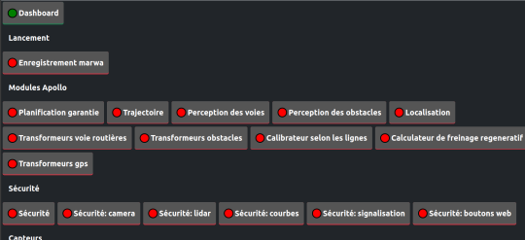
Web UI
https://github.com/irh-ca-team-car/apollo-dashboard
Node dashboard.mjs (need node 18+)
État (status) page has all buttons to start the previously named modules
See comments in status.raz file for the format for « launch files »
It autoruns on xavier boot

Slide 9
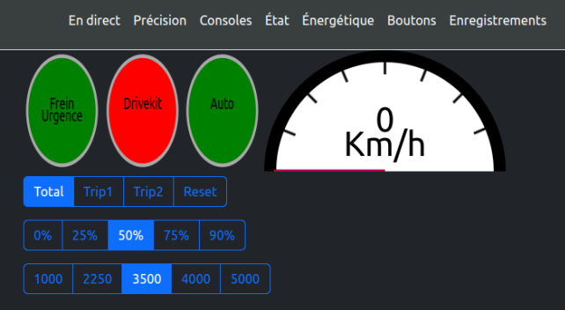
Web UI(2)
The buttons page contains
  Emergency stop button
  Drivekit Enable/Disable button
  Autonomous/Joystick button
  Max speed
  Energy parameters for the braking plannification

