Slide 1
Here all arrows should point to the digram parts:
arrows are not attached to the diagram

Slide 2
Here all arrows should point to the digram:
arrows are attached to the diagram borders

Slide 3
Another example
Text #1
Text #I
Text #II
Text #2-1
Text #2-2
Text #2-1-1
Text #2-1-2
Text #1 and #I attached on 1 end
Everything else attached on 2 ends
(Texts ## 2-1, 2-2, 2-1-1, 2-1-2, II)

Slide 4

A png recolored with Presentations (softmaker)
original*
«scheme-lighter shades»
*I am not an author of an original pictures, it’s used for testing purposes

Slide 5

A png recolored with Presentations (softmaker)
original
«scheme-lighter shades»

Slide 6
A png recolored with Presentations (softmaker)
original*
«scheme-darker shades»

Slide 7
A png recolored with Presentations (softmaker)
original
«scheme-darker shades»

Slide 8
A png recolored with Presentations (softmaker)
original*
«standard-lighter shades»
«standard-darker shades»

Slide 9
A png recolored with Presentations (softmaker)
original
«standard-lighter shades»
«standard-darker shades»

Slide 10
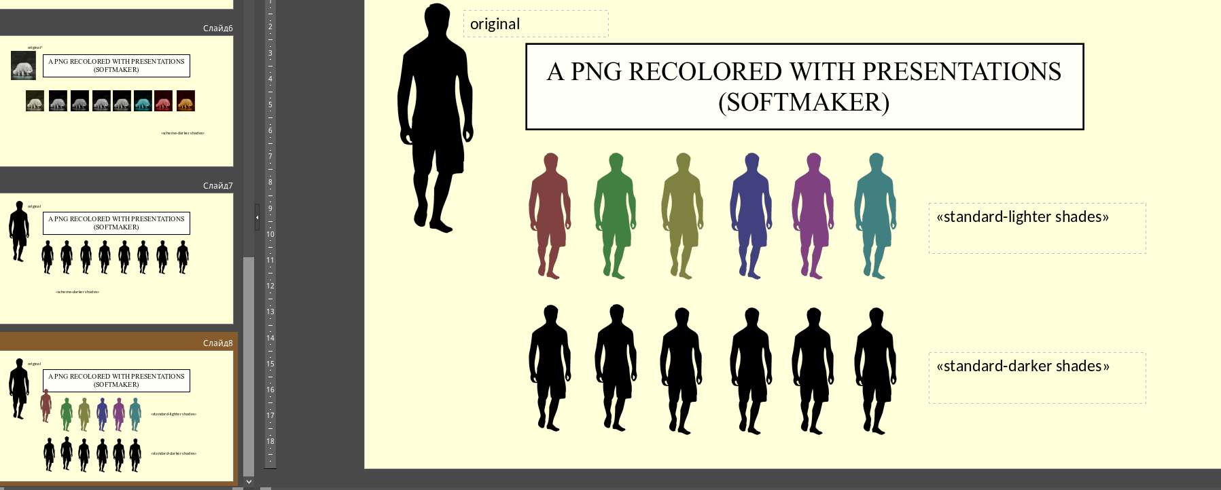
A bonus bug encountered while making this presentation

