Slide 1
Youth/Adult Career Pathway Partnerships
SW MN Private Industry Council (PIC)

Slide 2
Career Pathway Definitions
career pathway noun
a series of connected education and training programs and support services that enables people to secure or advance in employment within a specific industry of occupational sector.
career pathway noun
a combination of rigorous and high-quality education, training, and other services.
career pathway
a clear sequence of education coursework and/or training credentials which include several components.

Slide 3
Six Key Elements of Career Pathways
According to the DOL- ETA 2011
1. Build Cross-Agency Partnerships & Clarify Roles
2. Identify Sector or Industry Strategy and Engage Employers
3. Design Program
4. Identify Funding Needs & Sources
5. Align Policies & Programs
6. Measure System Change & Performance
Notes:
Six Key Elements of Career Pathways
According to the DOL- ETA 2011
1. Build Cross-Agency Partnerships & Clarify Roles
2. Identify Sector or Industry Strategy and Engage Employers
3. Design Program
4. Identify Funding Needs & Sources
5. Align Policies & Programs
6. Measure System Change & Performance

Slide 4
Build Cross- Agency Partnerships & Clarify Roles
Interagency Partnerships Supporting Youth/Adult Career Pathways
a.k.a
COLLABORATIONS
Local Workforce Council or Investment Board
Independent School Districts
Post-Secondary
Adult Basic Education
Local Employers
County Health and Human Services
MN Dept. of Corrections
MN Dept. of Public Safety
Regional Prevention Coordinators
MN Dept. of Human Services
PACER
University of MN Extension Center
Community Action Agencies
MN Disability Employment Initiatives
Vocational Rehabilitation Services
Integration Collaboratives
Notes:
Interagency Partnerships Supporting Youth/Adult Career Pathways
a.k.a
COLLABORATIONS
Local Workforce Council or Investment Board
Independent School Districts
Post-Secondary
Adult Basic Education
Local Employers
County Health and Human Services
MN Dept. of Corrections
MN Dept. of Public Safety
Regional Prevention Coordinators
MN Dept. of Human Services
PACER
University of MN Extension Center
Community Action Agencies
MN Disability Employment Initiatives
Vocational Rehabilitation Services
Integration Collaboratives

Slide 5
TOGETHER EVERYONE ACHIEVES MORE!
Notes:
TOGETHER EVERYONE ACHIEVES MORE!

Slide 6
Identify Sector or Industry and Engage Employer
The Young Adult Career Pathways project in SW MN is designed to provide fundamental job skills training tailored to the needs of regions local employers in high-growth, high-demand industries.
According to DEEDs Occupation in Demand Tool, Manufacturing, Healthcare, Retail, Transportation, Construction, and Mechanical Industries are just a few of those industries listed as "well above average" demand and growth in SW MN.
Avera Marshall Medical Center,
Schuneman Equipment,
Ritalka, and
various other employers
Notes:
The Young Adult Career Pathways project in SW MN is designed to provide fundamental job skills training tailored to the needs of regions local employers in high-growth, high-demand industries. According to DEEDs Occupation in Demand Tool, Manufacturing, Healthcare, Retail, Transportation, Construction, and Mechanical Industries are just a few of those industries listed as "well above average" demand and growth in SW MN.
Avera Marshall Medical Center,
Schuneman Equipment,
Ritalka, and
various other employers

Slide 7
Design Program
The Young Adult Career Pathways project in SW MN offers comprehensive training to youth and young adults, who traditionally face barriers to successful employment.
Tier 5-Placement
Work Experience
Unsubsidized Employment
Post-Secondary/enrollment in higher education career pathway/degree programs
Tier 1-Enhance awareness of resources and opportunities for career advancement.
Intake (Application/Eligibilty Verification):
Eligibilty verification, Social Security Number, DOB/Age, Residency, Release of Information,
and Data Privacy Notice.
Assessment, including but not limitied to:
Career Assessment- completed and interpreted by PIC staff
Work Readiness (Work Keys)- completed and interpreted by PIC staff
Basic Skills (Reading, Math, Digital Literacy)- supply CASAS scores to PIC staff
Tier 3- Industry Fundamentals
Learner Web
Work Readiness Skills
Employability Skills
Employer Panels
Value Added Career and College Readiness Activites
Business Tours
Labor Market Information
Financial Literacy
Register for minnesotaworks.net
Tier 4- Job Specific Skills/Credentials
First Aid/CPR
Medical Terminology
Nursing Assistant (CNA)
Trained Medical Administration (TMA)
Machine Tool
Welding
Construction Trades
Forklift
Serve Safe
Infection Control
etc.
Tier 2- Basic Training
ACTs Key Train- if CASAS scores are low.
ACTs National Career Readiness Certificate
(Must pass at Silver level or higher)
Skills Tutor
Learner Web
Junior Achievement
Career Ready 101
Notes:
Design Program
The Young Adult Career Pathways project in SW MN offers comprehensive training to youth and young adults, who traditionally face barriers to successful employment.
Add Pyramid

Slide 8
Identify Funding Needs and Sources
Braided Funding
Federal, state, and local employment and training dollars
Various funds from our Interagency Partners
Notes:
Identify Funding Needs and Sources
Braided Funding
Federal, state, and local employment and training dollars
Various funds from our Interagency Partners

Slide 9
Align Policies & Program
Prepares an individual to be successful in a full range of secondary and post-secondary education options;
Supports an individual in achieving the individuals' education and career goals in a manner which accelerates their educational and career advancement;
Enables an individual to attain stackable credentials (high school diploma, GED, college credit, and industry recognized credentials);
Makes work a central context for learning allowing individuals to attain and advance their work-readiness skills; and
Reflects active engagement of employers to align with the skill needs of high-growth, high-demand industries.
Notes:
Prepares an individual to be successful in a full range of secondary and post-secondary education options;
Supports an individual in achieving the individuals' education and career goals in a manner which accelerates their educational and career advancement;
Enables an individual to attain stackable credentials (high school diploma, GED, college credit, and industry recongized credentials);
Makes work a central context for learning allowing individuals to attain and advance their work-readiness skills; and
Reflects active engagement of employers to align with the skill needs of high-growth, high-demand industries.

Slide 10
Measure System Change & Performance
August 15th, 2013 through September 30th, 2015
Demographics
63 Total Participants
Average Age: 18 years old
30% or more Not Employed at enrollment.
20% Lack Work Experience/History/Skills
25% Low Income
15% MFIP Teen Parents
10% English Acquisition Learners
5% Foster Child
August 15th, 2013 through September 30th, 2015
Outcomes
40% Obtain Unsubsidized Employment
Avg. wage at enrollment: $9.02
Avg. wage at exit: $10.55
15% went on to Further Education
55% obtained college credit, academic credit, and industry-recognized credentials.
45% either returned to Secondary school or achieved their goals.

Slide 11
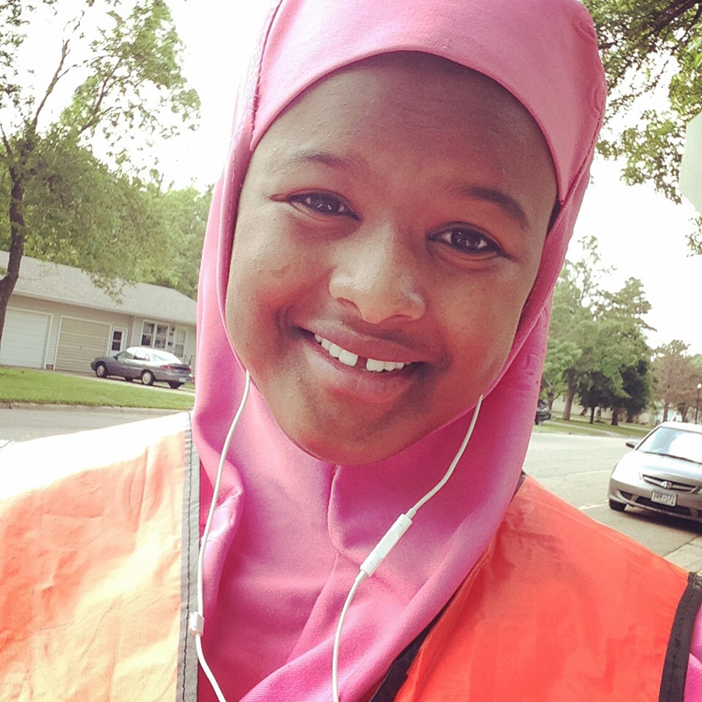
Success Story

Slide 12
??? QUESTIONS ???
Notes:
??? QUESTIONS ???

Slide 13
Eriann Faris, MS, GCDF
SW MN Private Industry Council
Youth Program Manager
efaris@swmnpic.org
507-476-4053 (office)
507-829-8168 (cell)
Notes:
Eriann Faris, MS, GCDF
SW MN Private Industry Council
Youth Program Manager
efaris@swmnpic.org
507-476-4053 (office)
507-829-8168 (cell)

